Slide 1
Flow of Control
By Sandhya

Slide 2
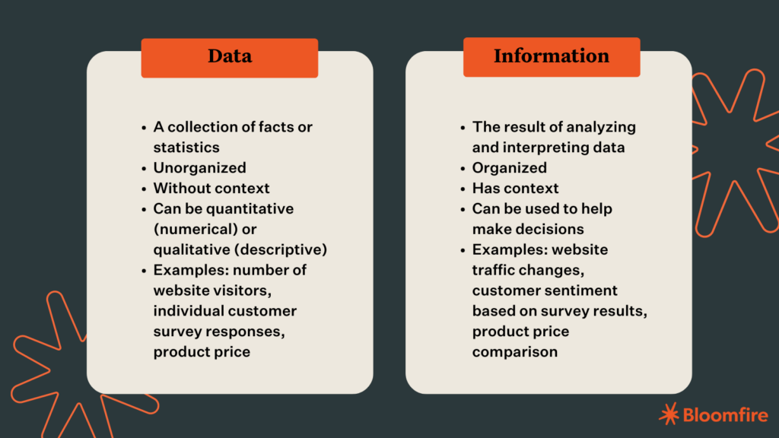
What is Data and Information
Notes:
Adarsh

Slide 3
What are Data types
In software programming, data type refers to the type of value a variable has and what type of mathematical, relational or logical operations can be applied without causing an error. For example, many programming languages use the data type string to classify text, integer to identify whole numbers and floating point to designate numbers with decimal points.

Slide 4
Different data types
String (or str or text). Used for a combination of any characters that appear on a keyboard, such as letters, numbers and symbols.
Character (or char). Used for single letters.
Integer (or int). Used for whole numbers.
Float (or Real). Used for numbers that contain decimal points, or for fractions.
Boolean (or bool). Used where data is restricted to True/False or yes/no options.

Slide 5
Operators and Expressions
Expressions perform specific actions, based on an operator, with one or two operands. An operand can be a constant, a variable or a function result. Operators are arithmetic, logical, and relational. As with C, some operators vary in functionality according to the data type of the operands specified in the expression.

Slide 6
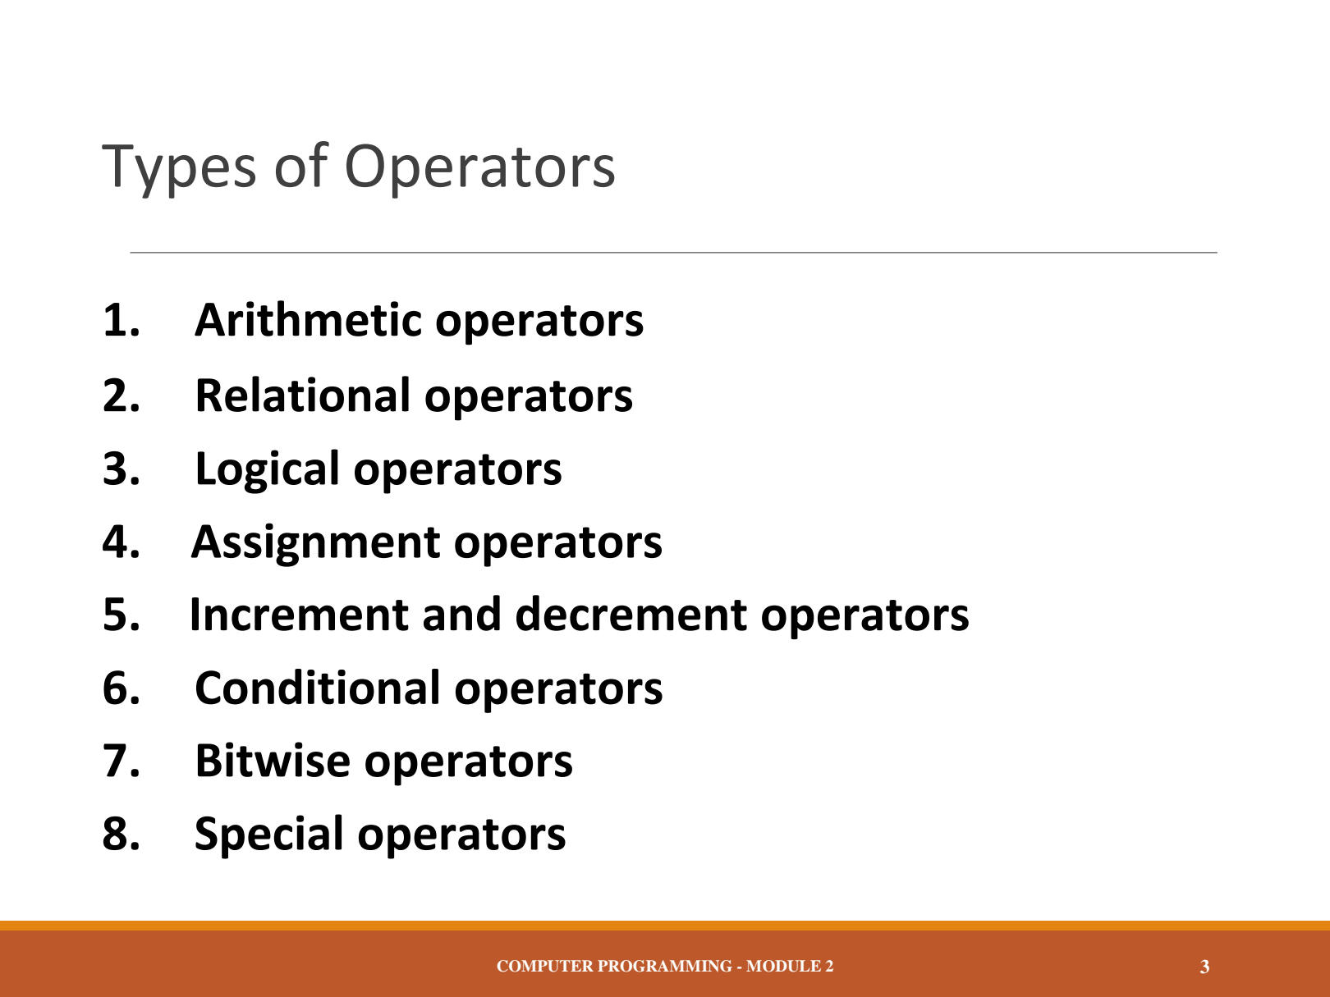

Slide 7
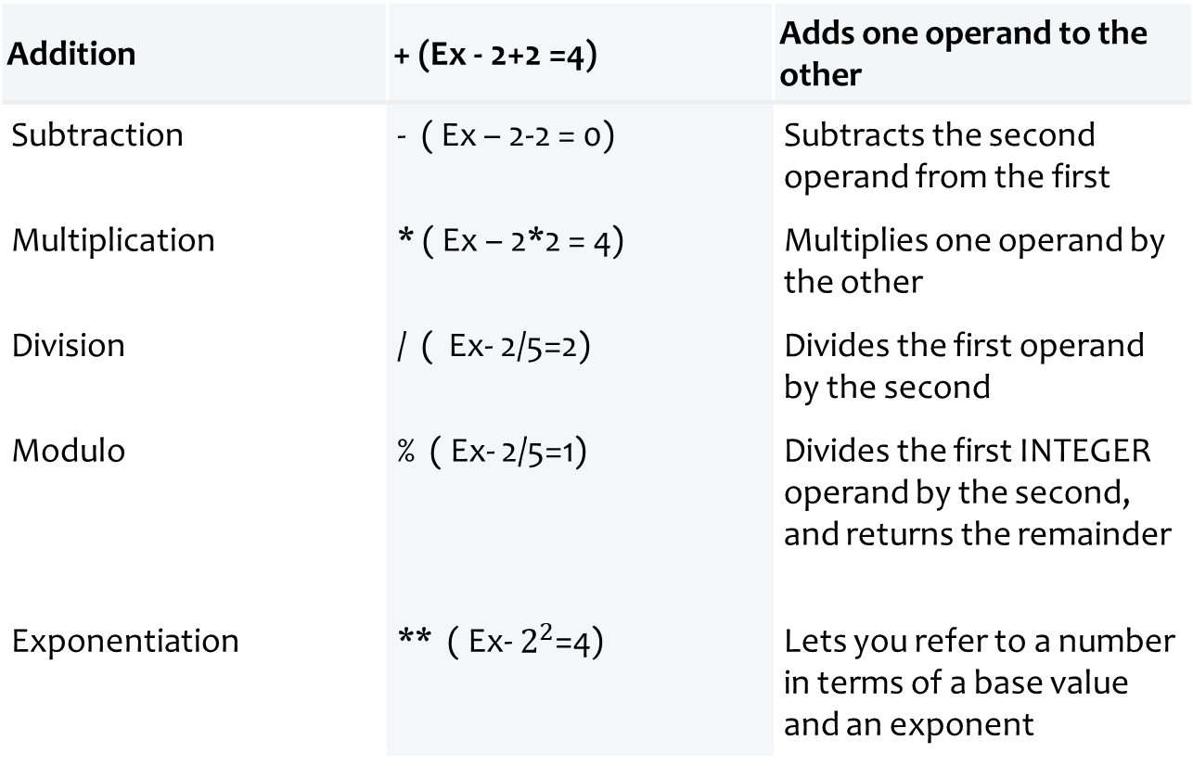
Arithmetic Operators
Addition | + (Ex - 2+2 =4) | Adds one operand to the other
Subtraction | - ( Ex – 2-2 = 0) | Subtracts the second operand from the first
Multiplication | * ( Ex – 2*2 = 4) | Multiplies one operand by the other
Division | / ( Ex- 2/5=2) | Divides the first operand by the second
Modulo | % ( Ex- 2/5=1) | Divides the first INTEGER operand by the second, and returns the remainder
Exponentiation | ** ( Ex- $2^{2}$=4) | Lets you refer to a number in terms of a base value and an exponent

Slide 8
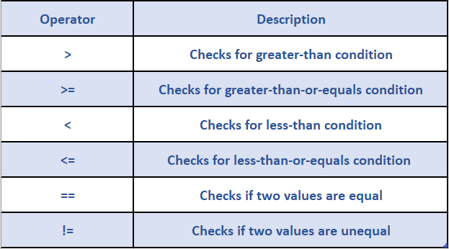
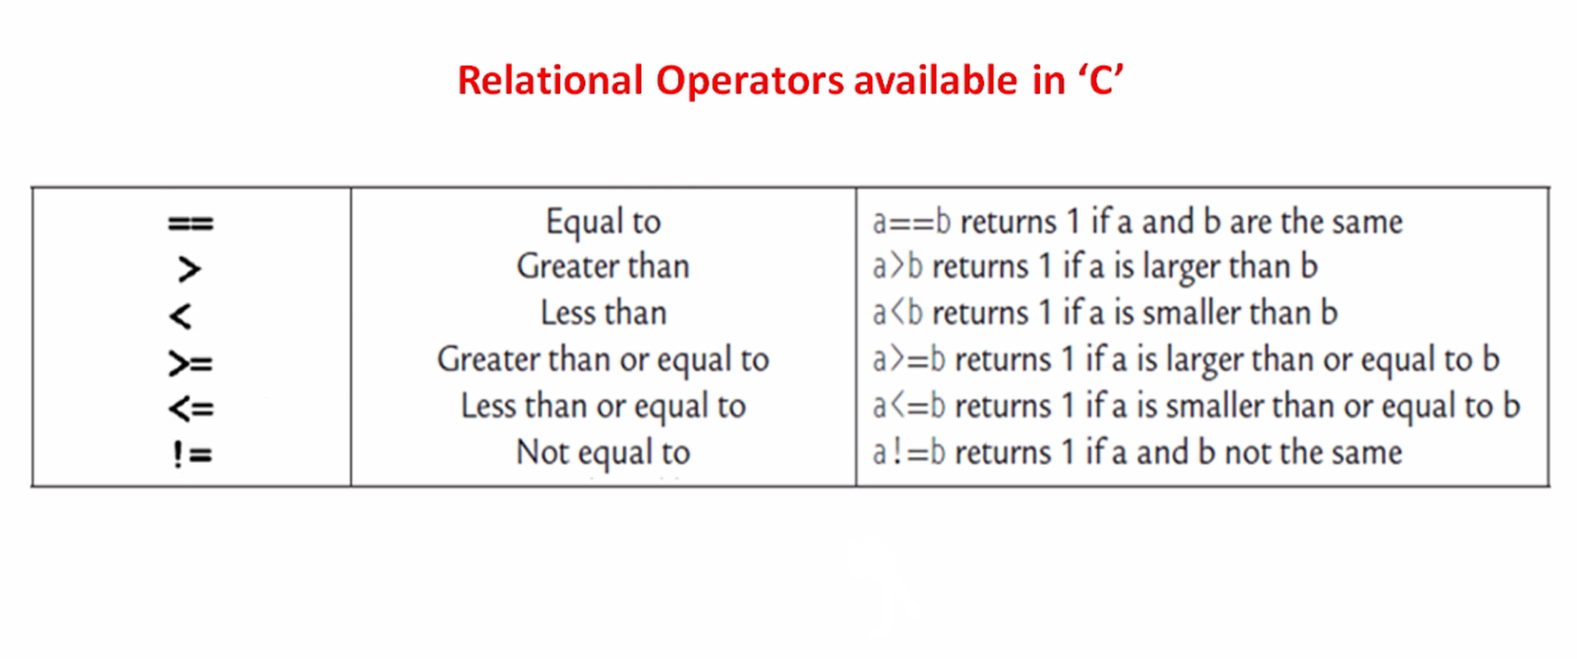
Relational Operators
Example
5>2= True
5>=2=True
5<2= False
5<=2= False
5==5= True
5!=2= True

Slide 9
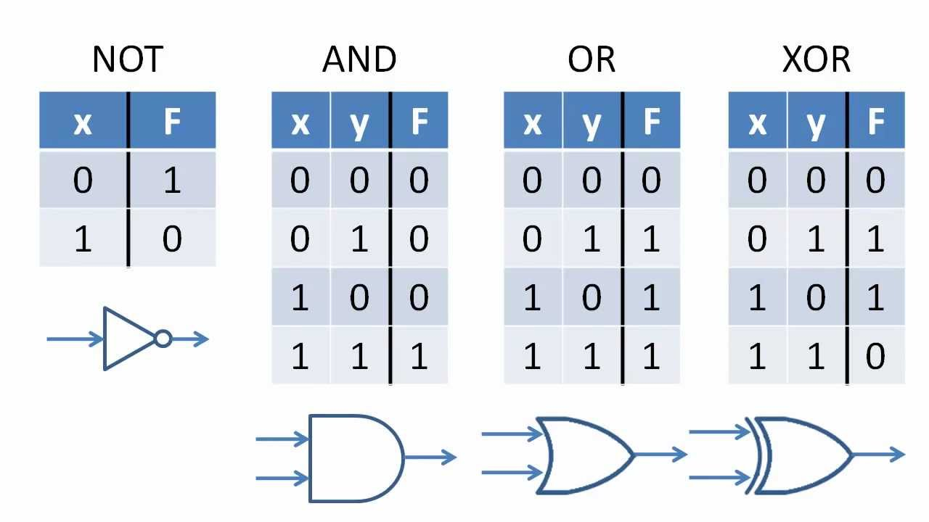
Logical Operators

Slide 10
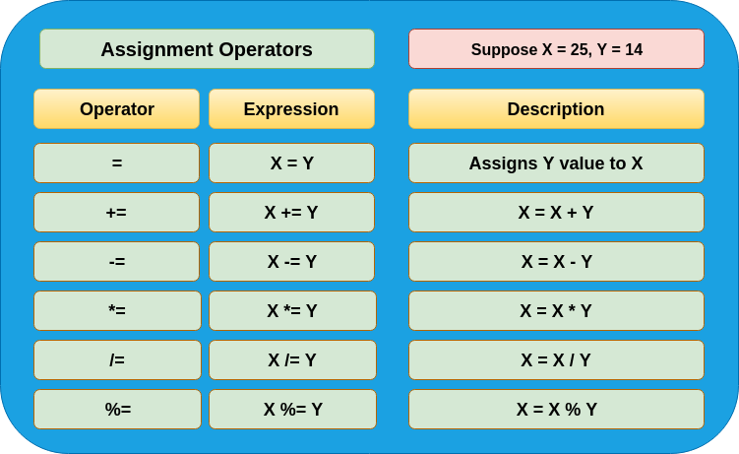
Assignment Operators

Slide 11
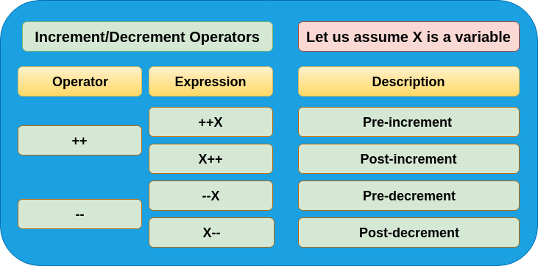
Increment and Decrement Operators

Slide 12
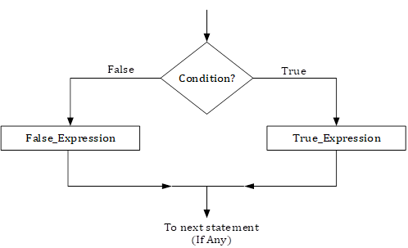
Conditional Operators
=if(marks>33,”Pass”,”fail”

Slide 26
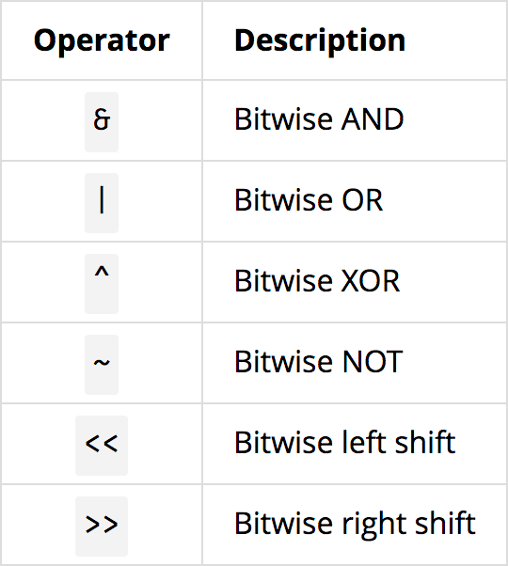
Bitwise Operators

Slide 27
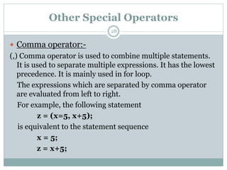
Special Operators

Slide 28
Statements and Statement Flow Control
The script interpreter processes statements sequentially starting with the first statement of the program block. This sequential flow can be controlled with conditional statements that perform branching and iteration. Branching is controlled with an IF statement that directs execution along a given path. Iteration is controlled with loop statements that execute one or more statements repeatedly.

Slide 29
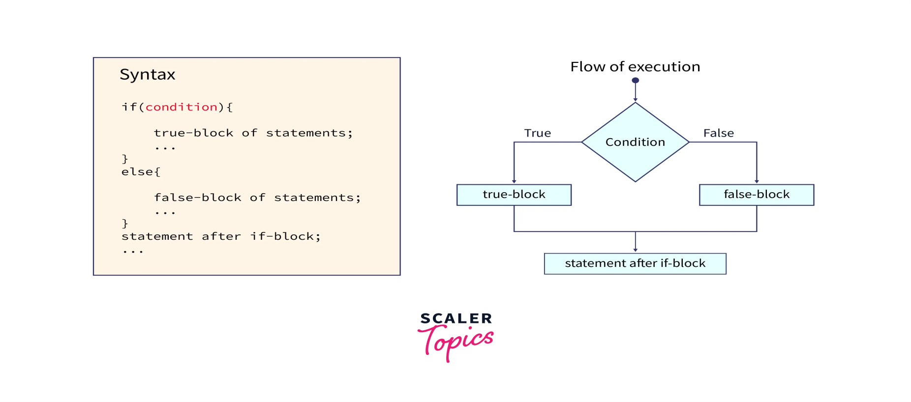
Selection Statements
Selection statements are also known as branching statements or conditional or decision-making statements. It is used to select part of a program to be executed based on condition.

Slide 30
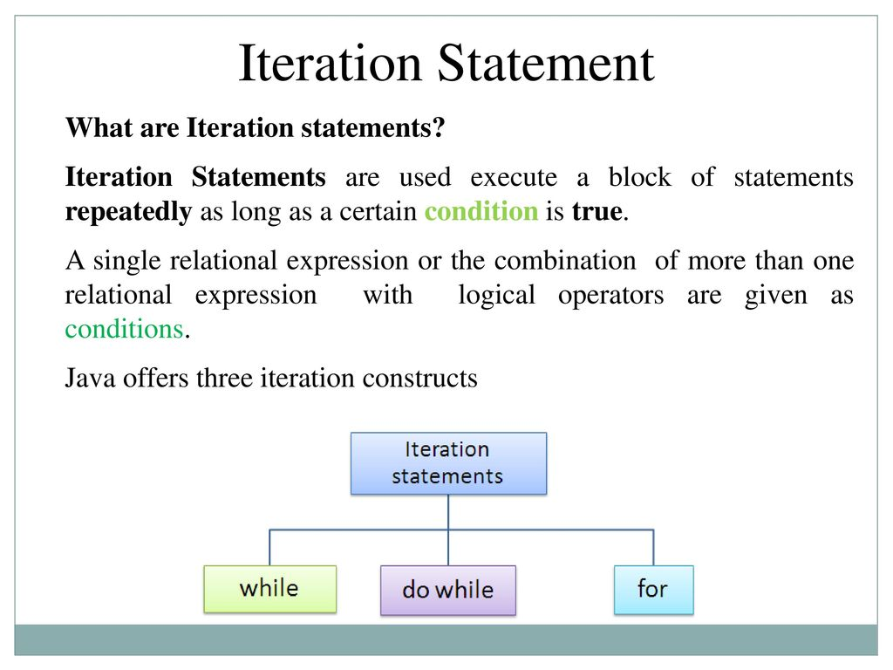
Iteration Statements

Slide 31
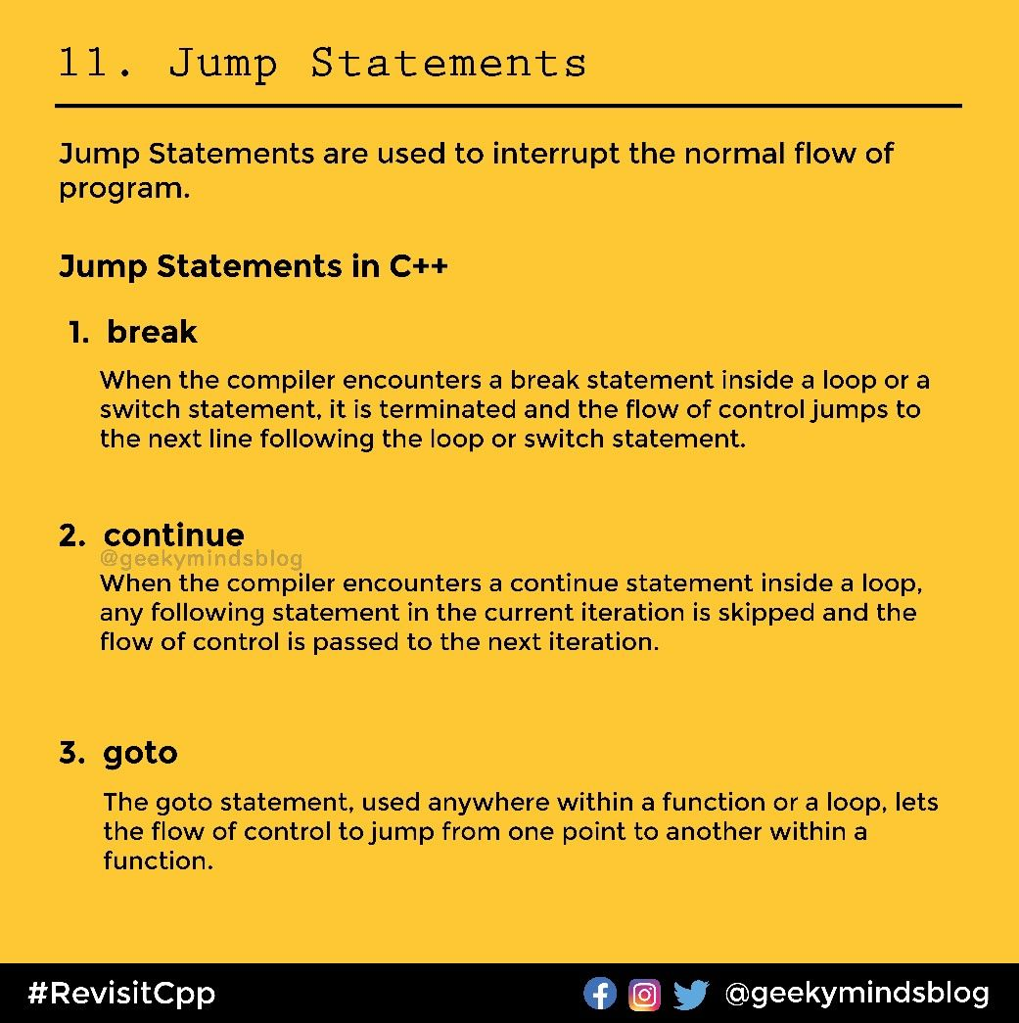
Jump Statement

Slide 32
Thank You

